Slide 1
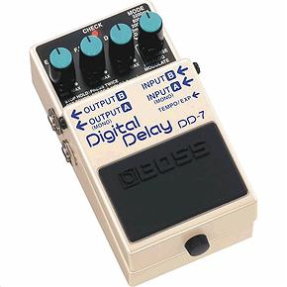
Delay-Based Effects

Slide 2
Basic delay
From a digital system perspective, delay is simple:
Difference equation adding the current input sample to one D samples prior
y[n]=x[n]+ax[n-D] | a|<1 (usually)
For audio:
Delay ranges from milliseconds to several seconds
What values of D does this imply for sampling rate= 44.1kHz?
x[n]
y[n]
Delay (D)
g
+
1 second =
44100 samples
22.6µS
= 1 sample
1 ms =
~ 44 samples

Slide 3
Basic delay: aesthetics
Takes audio and plays it back after delay time
One of the simplest audio effects
Use delay to:
Bring to life dull mixes
Widen an instrument’s sound
Solo over yourself
Delay is building block for other effects
Echo
Reverb
Chorus
Flanging
...

Slide 4
Delay with feedback
Most delays have feedback control (regeneration)
takes delay output, sends it back to input
repeat sound over and over
Quieter each time it plays back
assuming feedback gain is less than one
Most delay devices restrict gain to less than one for stability
after some point, drops below noise floor → inaudible
g_{FB}
Basic delay unit with feedback
x[n]
y[n]
+
Delay N
g_{FF}
+

Slide 5
Delay with feedback
To derive y[n] in terms of x[n]:
d[n]=g_{FF}{x[n-N]+g_{FB}d[n-N]} , y[n]=x[n]+d[n]
→
d[n-N]=y[n-N]-x[n-N]
d[n]=g_{FF}{x[n-N]+g_{FB}d[n-N]}
y[n]=x[n]+g_{FF}{x[n-N]+g_{FB}d[n-N]}
=x[n]+g_{FF}{x[n-N]+g_{FB}(y[n-N]-x[n-N])}
=x[n]+g_{FF}(1-g_{FB})x[n-N]+g_{FF}g_{FB}y[n-N]
g_{FB}
x[n]
y[n]
+
Delay N
g_{FF}
d[n]
+

Slide 6

Sound samples
Delays applied to a pulse-like sound
Original pulse
Processed with 60 ms delay (no feedback)
100 ms delay
150 ms delay
250 ms delay
250 ms delay with feedback
250 ms delay with higher feedback gain

Slide 7

Delay on an instrument
Playing through delay unit with short echo, say 50 to 100 milliseconds, creates doubling effect
Useful for filling out an instrument's sound
Like two instruments being played in unison
Several delays together with feedback can create reverb-like sound
simple guitar riff, followed by the same riff, but with added delay 40 ms., doubling the sound

Slide 8
Long delays
Delay times above 100ms no longer a subtle effect
Can match delay time to tempo of song
Delayed copies of sound fall on a beat
Extending to very long delays: 1 second or more
Can play over yourself
develop harmonies even though you may only play one note at a time
See A Study of The Edge’s (U2) Guitar Delay by Tim Darling
http://www.amnesta.net/edge_delay/
can use long delay to layer notes
delay time used here is 1.5 seconds

Slide 9
Looping and sampling
Record only a segment of playing and loop it
e.g. a chord progression
Play recorded audio over and over
Solo over yourself, without rhythm player
Some delay pedals include sampling capability
Length of sample often limited to 2 seconds or less
For serious looping, need longer recording time
Memory depends on duration, sample rate, bit depth
Popular units offer additional capabilities
Recording additional sounds onto sample
Playing loop backwards
Recording several different loops

Slide 10
Delay and mixing
Important when mixing for stereo
Enhance stereo placement of instruments
Make mix sound “bigger”
Small delay can be more effective than panning for spreading tracks out in stereo field
Simple delay ca. 20ms can make big difference
We discuss this when covering spatial effects
riff initially mixed to center of stereo mix.
followed by same riff with 20 ms delay between 2 channels.
NO panning involved - just pure delay with no feedback.

Slide 11
Slapback and echo
Slapback delay is not new algorithm
same as basic delay without feedback
Delay is called slapback delay if delay time fairly short
between 40 and 120 milliseconds.
Longer delay called echo

Slide 12
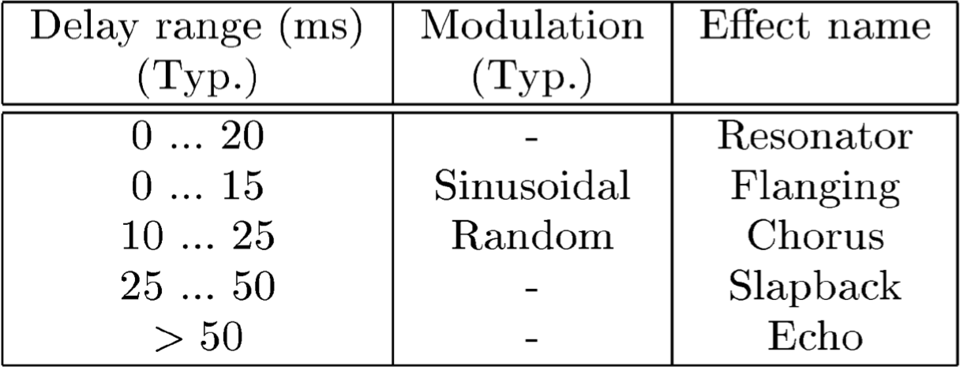
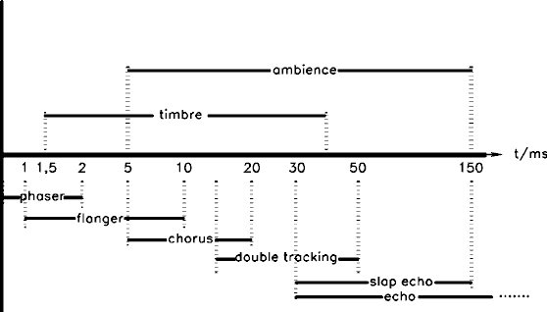
Typical effect delay times
(We’ll see these
other effects soon!)

Slide 13
Multi-tap delay
Simple delay: outputs taken after total delay time
Multi-tap delay is more flexible
Take outputs after only portion of delay time
Known as tapping the delay line
Like tap in water pipe allows you to get water at various points
Units labeled with number of available taps
3-tap delay has 3 taps to use, a 4-tap has 4, etc.
Unwanted taps removed by setting output level to 0
Amount of delay between taps can be different
x[n]
+
z^{-N1}
z^{-N2}
z^{-N3}
z^{-N4}
4-tap delay in action
y[n]
+
+
+

Slide 14

Multi-tap delay
General case of basic delay design
Set all but one tap gain to 0, place remaining tap at delay line end → results in basic delay line
Multi-tap delay can be generalised further
Allow feedback from each delay output to beginning
Easy to create unstable system!
Looking only at single tap
Sound repeats according to total delay time
Input sound will appear at tap output before total delay time (except last, rightmost tap)
sound produced with 4-tap delay
same sound with fourth tap moved 80 ms. closer to input
sound with increased total delay time increased by 200 ms. (i.e., Delay 5 in the diagram increased by 200 ms.).

Slide 15
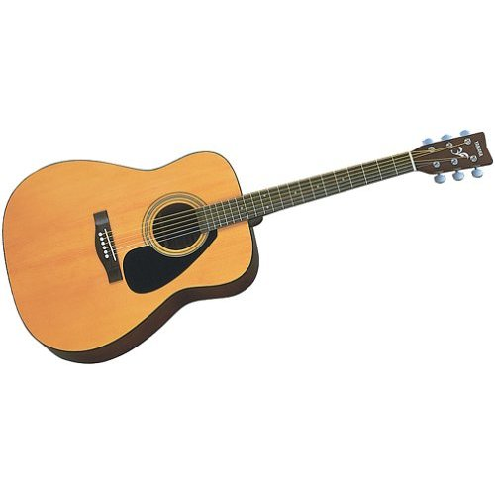
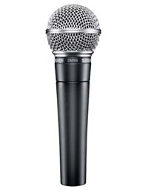
Delay in the recording process
Suppose we record instrument with two microphones
Sound travels at 340.3m/s
If mics are 2m apart, sound arrives 5.9ms later to the distant mic
Adding closely timed similar signals creates phase problems
Selective cancellation of certain frequencies
Can be used deliberately as musical effect (more on this soon)
Solution: delay the close mic to compensate
Delay
5.9ms
2m = 5.9ms

Slide 16
Digital delay implementation
Operation
Read an input recorded previously
Store current input in another memory location
Or may be same location that was just read
This is why value read before writing
Next sampling period
Read & write next location in memory
When end of memory, loop around to first memory location
This is a circular buffer, and it is quite efficient
Programming delays
Read and write pointers keep track of where to read/write in memory
Pointers increment each sample
Multi-tap delays created using additional read pointers

Slide 17
Delay on a circular buffer
read pointer
write pointer
x[0]
x[1]
x[2]
x[3]
x[4]
x[5]
x[6]
x[7]
x[8]
x[9]
x[10]
x[11]
x[12]
x[1]
x[2]
x[3]
x[4]
x[5]
x[6]
x[7]
x[8]
x[9]
x[10]
x[11]
x[12]
x[13]
x[2]
x[3]
x[4]
x[5]
x[6]
x[7]
x[8]
x[9]
x[10]
x[11]
Buffer is a contiguous block of memory
Read and write pointers point to specific locations within this block
Difference in read/write pointer location determines delay
This is equivalent to difference equation representations

Slide 18
Delay code
Our Delay effect will be simple VST plugin
Start with HelloWorld UI from Getting Started
Use the first, generic version
Define variables in pluginprocessor.h
Set up the variables in prepareToPlay
Edit processBlock so that it implements delay
Use read and write pointers on circular buffer
Make sure that incrementing pointer on one channel does not affect other channels

Slide 19
Define and initialise
Add private parameters to pluginProcessor.h
Set up delay buffer in prepareToPlay on pluginProcessor.cpp
Parameters on interface
private:
juce::AudioParameterFloat* delayTimeParam;
juce::AudioParameterFloat* feedbackParam;
juce::AudioParameterFloat* dryWetMixParam;
juce::AudioSampleBuffer delayBuffer;
int delayBufferLength;
int delayReadPosition, delayWritePosition = 0;
Circular buffer variables for implementing delay
Allocate delay buffer, size depends on sample rate
void NewProjectAudioProcessor::prepareToPlay (double sampleRate, int samplesPerBlock) {
auto delayTime = delayTimeParam->get();
delayBufferLength = (int)(2.0 * sampleRate);
delayBuffer.setSize(2, delayBufferLength);
delayBuffer.clear();
delayReadPosition = (int)(delayWritePosition - (delayTime * getSampleRate())
+ delayBufferLength) % delayBufferLength;
}
determine delay position offset in samples
Notes:
MidiKeyboardComponent needs a MidiKeyboardState and the orientation as arguments.

Slide 20
processBlock 1 - Define variables
Information about these samples
Set up the basics in the processBlock method on pluginProcessor.cpp
const int numInputChannels = getTotalNumInputChannels();
const int numOutputChannels = getTotalNumOutputChannels();
const int numSamples = buffer.getNumSamples();
float sampleRate = (float)juce::AudioProcessor::getSampleRate();
auto dryWetMix = dryWetMixParam->get();
auto feedback = feedbackParam->get();
auto delayTime = delayTimeParam->get();
int channel, dpr, dpw; // dpr = delay read pointer; dpw = delay write pointer
delayReadPosition = (int)(delayWritePosition - (delayTime * getSampleRate())
+ delayBufferLength) % delayBufferLength;
Notes:
must pass MidiKeyboardState object to initialise MidiKeyboardComponent object

Slide 21
processBlock 2 – apply effects to each cannel
channelData is numSamples of audio for one channel
for (channel = 0; channel < numInputChannels; ++channel) {
float* channelData = buffer.getWritePointer(channel);
float* delayData = delayBuffer.getWritePointer(jmin(channel,delayBuffer.getNumChannels() -1));
dpr = delayReadPosition;
dpw = delayWritePosition;
for (int i = 0; i < numSamples; ++i) {
float in = channelData[i];
float out = (1- dryWetMix) * in + dryWetMix * delayData[dpr];
delayData[dpw] = in + (delayData[dpr] * feedback);
if (++dpr >= delayBufferLength) dpr = 0;
if (++dpw >= delayBufferLength) dpw = 0;
channelData[i] = out;
}
}
delayReadPosition = dpr;
delayWritePosition = dpw;
delayData is circular buffer for finding delay on this channel
Copy state variables maintained between processBlock calls. Processing channel can't affect state variable for next one
Store info in delay buffer. delayData[dpr] is delay sample we just read. delayData[dpw] is what we write to buffer
Store output sample in buffer, replacing input
transfer local copies back to main state variable
Notes:
must pass MidiKeyboardState object to initialise MidiKeyboardComponent object

Slide 22


Fractional delay
x[n]
y[n]
Delay (D)
g
+
What happens when we want non-integer D?
x[n] undefined if n is not an integer
Consider this discrete/continuous system:
D / C
Delay
C / D
dT = 10.4µs
(0.5 samples)
48kHz
48kHz

Slide 23
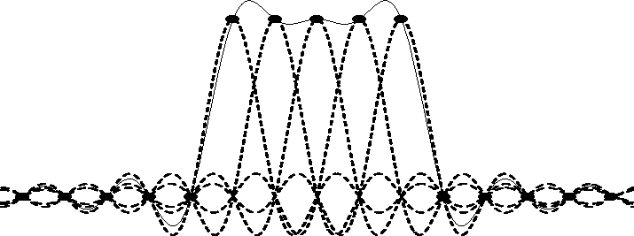


Fractional delay
Ideal discrete-to-continuous converter
“sinc reconstruction”
Delay of D samples corresponds to a convolution:
Not causal
Infinitely long convolution
https://ccrma.stanford.edu/~jos/st/Introduction_Sampling.html
where
Full derivation: Oppenheim, Schafer and Buck, Discrete-Time Signal Processing, 2nd ed., Sec 4.5

Slide 24
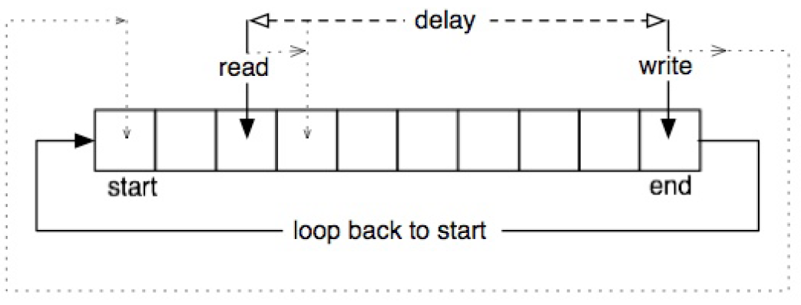
Fractional delay in practice
Use interpolation between samples
Linear (fast), second order or cubic (better quality)
Pseudocode (next slide...)
Input:
An input signal x[n] at sampling rate R
Required delay line size D
Starting delay for read pointer initialdelay
Read pointer update rate updateread (write pointer update rate=1)
Output:
N samples of signal y[n] at sampling rate R (output of read pointer)

Slide 25
Fractional delay in practice
Allocate buffer delayline of size D for storing samples
writepos=0; // write pointer position, start at beginning of buffer
readpos=(writepos+D-initdelay)%D;// read pointer position, modulo keeps indexing correct
for (n=0; n<=N-1; n++)
{
prev=floor(readpos); // get previous integer index
next=(prev+1)%D; // get next integer index; because of wraparound, need modulo for safety
t=readpos – prev; // get fractional position of read pointer
y[n]=(1-t)*delayline[prev]+t*delayline[next]; // Linear interpolation
readpos=(readpos+updateread)%D; // update read pointer for next time, modulo wraps
delayline[writepos]=x[n]; // write current sample to delay line
writepos=(writepos+1)%D; // update write pointer for next time, modulo wraps
}
Code doesn’t check whether pointers cross
won’t happen when moving at same speed
pointers moving at different speeds here
Read always happens before write to delays of full buffer length
Should work properly

Slide 26
Ping-pong delay
For stereo audio systems
Creates bouncing effect
Sound typically jumps between left and right channels
2 delay lines with 2 inputs, 2 outputs
Can use same signal for each input
Typically pan outputs hard left and hard right
Feedback from each delay line goes to opposite line
x₁[n]
y₁[n]
z^{-N}
ping-pong delay
1st sequence generated with symmetric setup (delays same length, same feedback gain) panned hard left and right
2nd sequence breaks symmetry and panning
x₂[n]
y₂[n]
z^{-N}

Slide 27
Lets work out the transfer functions
x₁[n]
y₁[n]
z^{-N}
x₂[n]
y₂[n]
z^{-N}

Slide 28
X₁(z)
W₁(z)
Y₁(z)
a₁
z^{-N}
c₁
b₁
b₂
X₂(z)
Y₂(z)
a₂
z^{-N}
c₂
W₂(z)
W₁ (z)=[b₁W₂ (z)+a₁X₁ (z)] z^{-N}
W₂ (z)=[b₂W₁ (z)+a₂X₂ (z)] z^{-N}
Solve these equations for W₁
→b₁ b₂W₁z^{-2N} + b₁ a₂X₂ z^{-2N}+a₁X₁z^{-N} =W₁
W₁=[a₂ b₁ X₂ z^{-2N}+a₁X₁ z^{-N}]/[1-b₁ b₂ z^{-2N} ]
Now plug into
Y₁ (z) = c₁W₁ (z)+X₁ (z)
...and similar for the other channel

Slide 29
Define and initialise
Add private parameters to pluginProcessor.h
Set up delay buffer in prepareToPlay on pluginProcessor.cpp
juce::AudioParameterFloat* delayTimeParam;
juce::AudioParameterFloat* leftRightDelayTimeParam, rightLeftDelayTimeParam;
juce::AudioParameterBool* linkDelaysParam;
juce::AudioParameterBool* reverseChannelsParam;
…
int delayReadPosition
int delayReadPositionLeft, delayReadPositionRight;
auto delayTime = delayTimeParam->get(); …
delayReadPosition = (int)(delayWritePosition - (delayTime * getSampleRate())
+ delayBufferLength) % delayBufferLength;
auto leftRightDelayTime = leftRightDelayTimeParam->get();
auto rightLeftDelayTime = rightLeftDelayTimeParam->get();
delayReadPositionLeft = (int)(delayWritePosition - (leftRightDelayTime * sampleRate)
+ delayBufferLength) % delayBufferLength;
delayReadPositionRight = (int)(delayWritePosition - (rightLeftDelayTime * sampleRate)
+ delayBufferLength) % delayBufferLength;
Notes:
MidiKeyboardComponent needs a MidiKeyboardState and the orientation as arguments.

Slide 30
processBlock 1 - Define variables
Set up the basics in the processBlock method on pluginProcessor.cpp
…
auto delayTime = delayTimeParam->get();
auto leftRightDelayTime = leftRightDelayTimeParam->get();
auto rightLeftDelayTime = rightLeftDelayTimeParam->get();
auto reverseChannels = reverseChannelsParam->get();
// these are arrays of length numSamples which contain a chnnel’ audio
float* channelDataL = buffer.getWritePointer(0);
float* channelDataR = buffer.getWritePointer(1);
// these are the circular buffers for implementing delay
float* delayDataL = delayBuffer.getWritePointer(0);
float* delayDataR = delayBuffer.getWritePointer(1);
for (int i = 0; i < numSamples; ++i) {
…
}
Notes:
must pass MidiKeyboardState object to initialise MidiKeyboardComponent object

Slide 31
processBlock 2, loop over samples
//const float inL = channelDataL[i], inR = channelDataR[i];
float outL, outR;
if (reverseChannels) {
outL = (inL + dryWetMix * delayDataR[delayReadPositionLeft]);
outR = (inR + dryWetMix * delayDataL[delayReadPositionRight]);
} else {
outL = (inL + dryWetMix * delayDataL[delayReadPositionLeft]);
outR = (inR + dryWetMix * delayDataR[delayReadPositionRight]);
}
// Store output of one delay buffer into other, producing ping-pong effect
delayDataR[delayWritePosition] = inR + (delayDataL[delayReadPositionLeft] * feedback);
delayDataL[delayWritePosition] = inL + (delayDataR[delayReadPositionRight] * feedback);
if (++delayReadPositionLeft >= delayBufferLength) delayReadPositionLeft = 0;
if (++delayReadPositionRight >= delayBufferLength) delayReadPositionRight = 0;
if (++delayWritePosition >= delayBufferLength) delayWritePosition = 0;
// Store the output samples in the buffer, replacing the input
channelDataL[i] = outL;
channelDataR[i] = outR;
Notes:
must pass MidiKeyboardState object to initialise MidiKeyboardComponent object

